Slide 1

UBD Unit Template
Stage 1: Desired Results
Stage 2: Assessment Evidence
Stage 3: Learning Plan

Slide 2
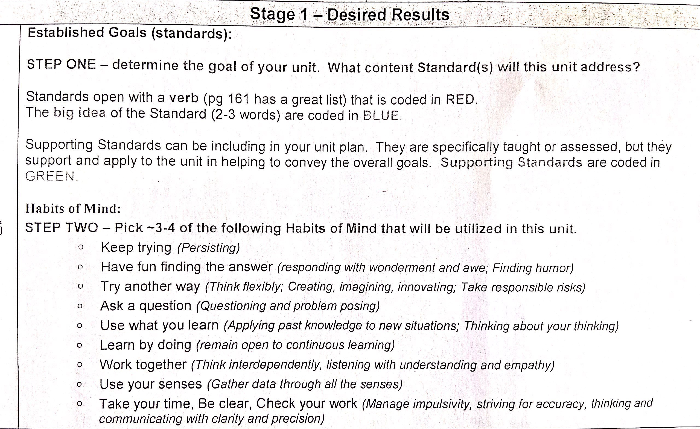

Slide 3
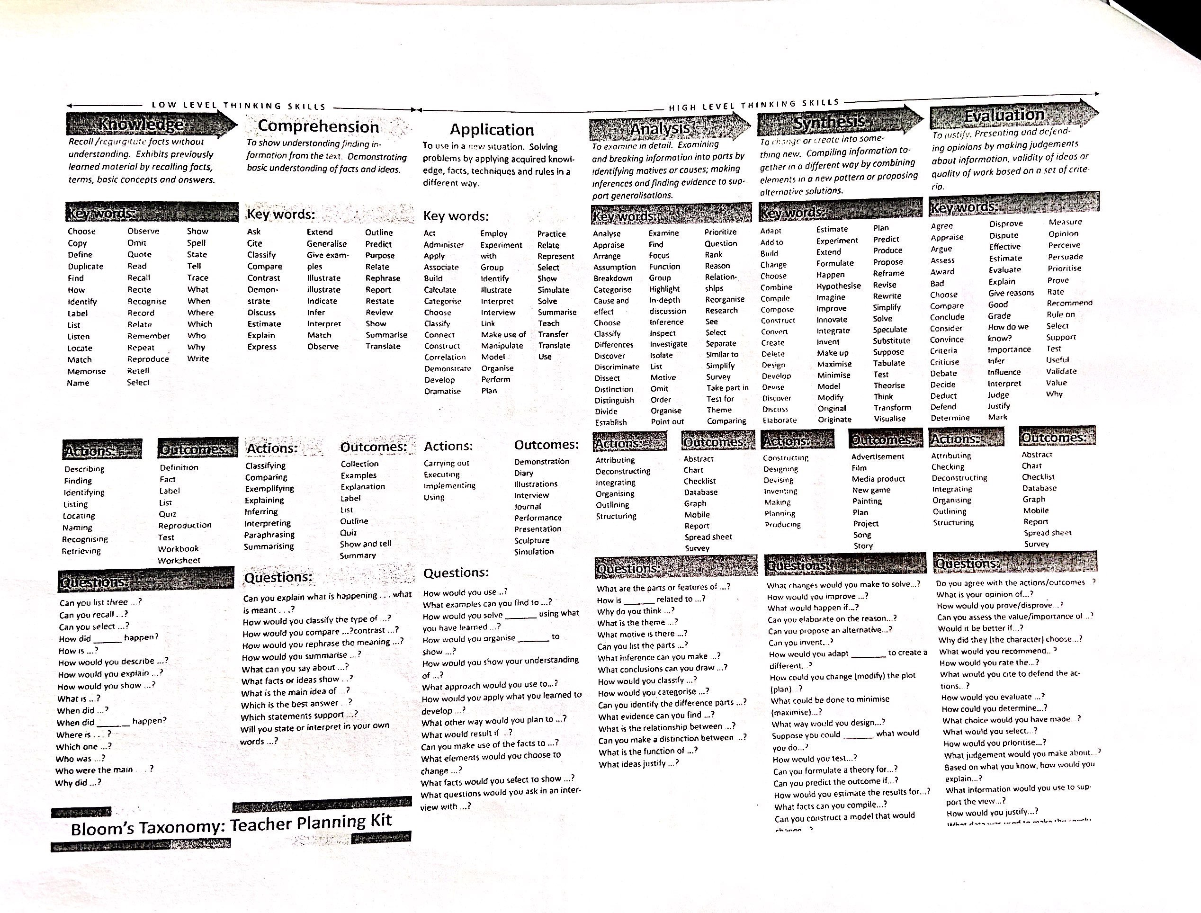

Slide 4
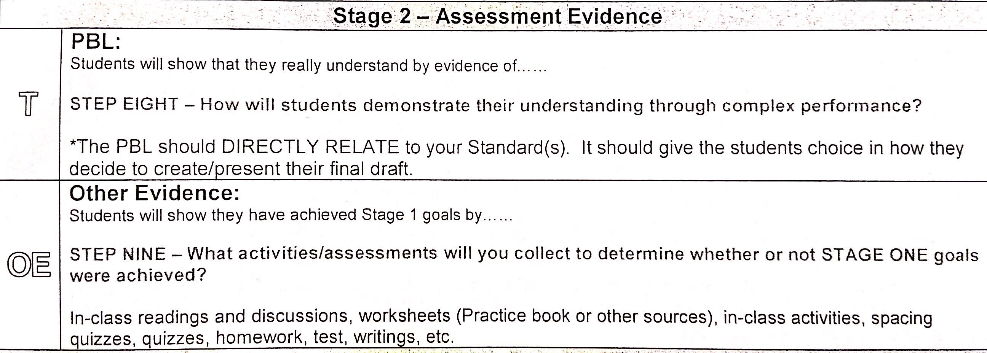

Slide 5
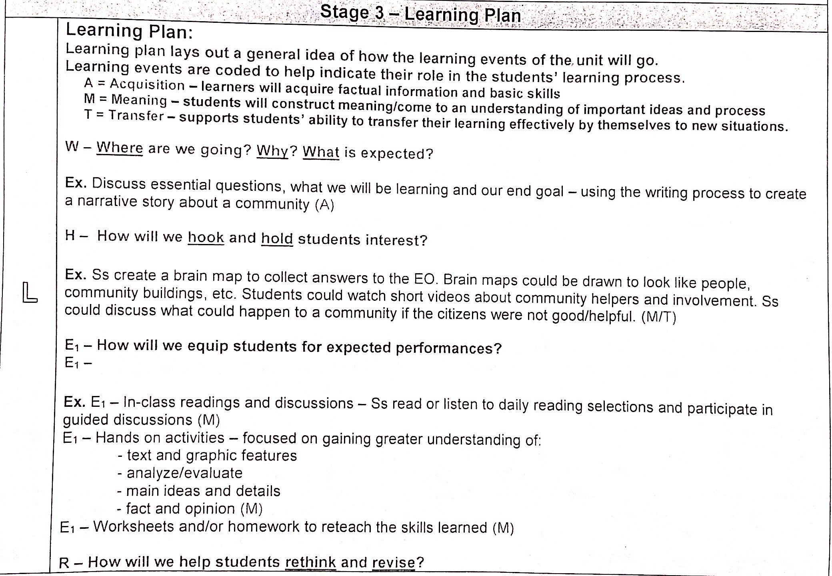

Slide 6

Set up Rules and Expectations
Class discussion: Why do we have rules? Reach the agreement.
Come up with the rules by themselves.
Act out a scenario. Ask students to think what rules fit it.
Concern differentiation.

Slide 7
Parents Communication
Parents don’t want to hear problems but your solutions.
Bring a lot of evidence when you are explaining to parents.

